Slide 1

Japan Shrine & Temple Navigator:
Personalized Guidance with GPT & Interactive Maps
2025/07/25
Advisor：Yi-Chung Chen
Members： Po-Yuan Chu, Bo-Min Zheng

Slide 2





Progress
Homepage
Map Mode
Chat Mode
Conclusion
This Week's Progress
Completed the UI prototype for the "Fukui Tourism AI," integrating two core features:
Interactive Map (Map Mode): Visually displays all attractions; users can click for details and instantly launch Google Maps for navigation.
Smart Chat (Chat Mode): Users can ask questions in natural language to receive personalized travel advice, powered by GPT-4o-mini.
Frontend
Backend
React 18
TypeScript
FastAPI
ChromaDB
Notes:
這週我們完成了「Fukui Tourism AI」的 UI 原型
“This week we finished the UI prototype for “Fukui Tourism AI.”
第一、地圖模式：所有景點一目了然，只要點擊就能直接開啟 Google Maps 導航。
The First is Map Mode – shows all attraction and launches Google Maps for directions with a single click.
第二、聊天模式：內建 GPT-4o-mini，旅客可以用自然語言提問，即時獲得個人化行程建議。
And second is Chat Mode – We use GPT-4o-mini, allowing users to ask questions in natural language and receive personalized advice on the spot.

Slide 3
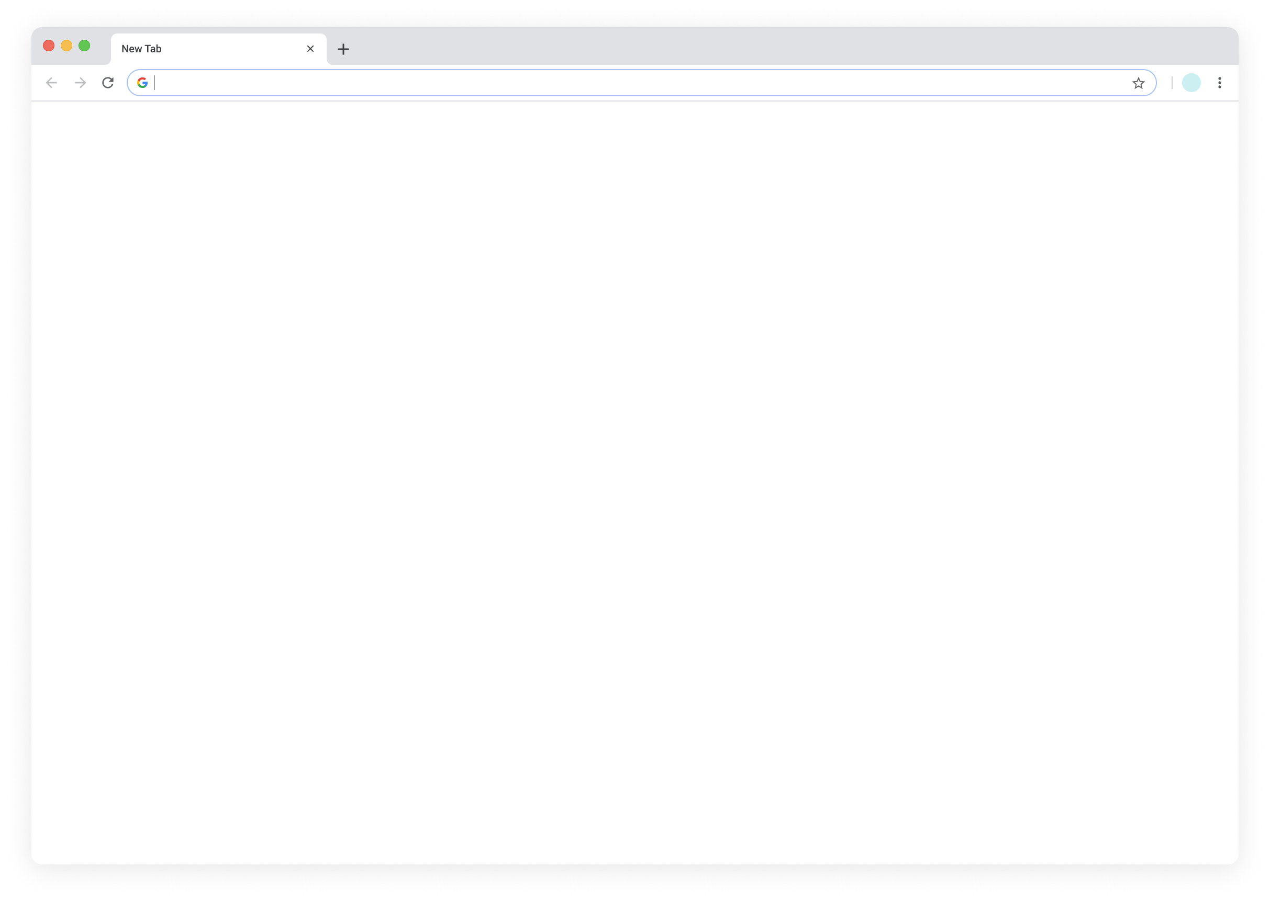
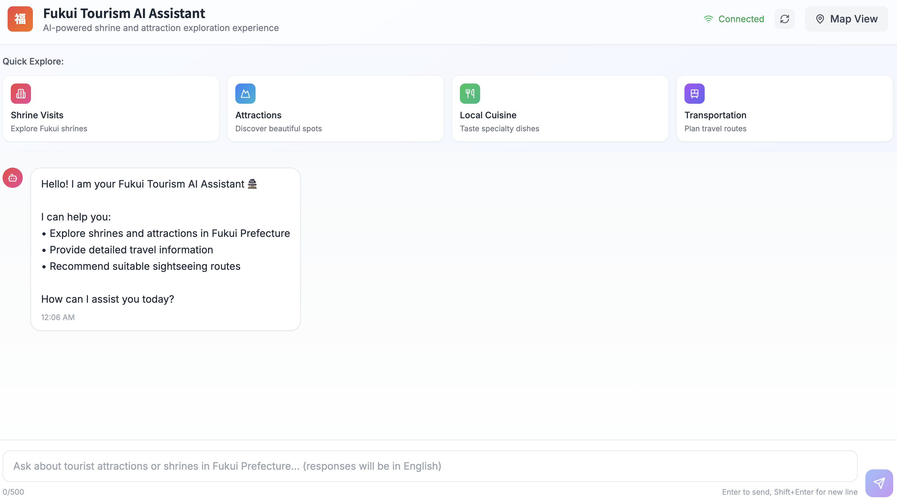
Progress
Homepage
Map Mode
Chat Mode
Conclusion
User Interface – Map Mode
Allows users to freely switch between "Chat Mode" and "Map Mode".
1
Mode Selection
Provides four main topic buttons: Guide users in starting a conversation quickly.
2
Quick Explore
Users can type any questions about Fukui travel here for real-time interaction with the AI.
3
User Dialogue Box
Notes:
「首先，我們看到的是使用者一進來會看到的主頁面。為了讓操作非常直觀，我們將畫面主要分成了三個區塊。」
“First, here’s the main page users see when they arrive. To keep things easy, we split it into three main sections.”
「第一個是右上角的**『模式選擇』**，使用者可以透過這個按鈕，在我們核心的『對話模式』和『地圖模式』之間自由切換。」
“First is the mode switch in the top-right corner. Users can click this button to flip between Chat mode and Map mode.”
「中間這排是**『快速問答』**區塊，我們設計了幾個最常見的旅遊主題，像是找神社、景點等等。使用者只要點一下，就能馬上開始探索，就算第一次使用也完全不用擔心不知道該問什
麼。」
"In the middle, is the Quick Ask area. We made buttons for common travel topics—like finding shrines or other sights. Just click one to start exploring right away, so even first-time users don’t have to worry about what to ask.”
「最下方則是**『使用者對話框』**，這是我們系統最核心的互動區塊，使用者可以在這裡輸入任何問題，直接跟我們的 AI 助理進行一對一的即時問答。」
“At the bottom is the chat box—the main place to interact. Users can type any question here and get answers from our AI assistant.”

Slide 4

Progress
Homepage
Map Mode
Chat Mode
Conclusion
User Interface – Map Mode
Entering Map Mode
By clicking the "Map View", the interface switches to Map Mode, allowing users to explore attractions in Fukui Prefecture visually.
Notes:
「介紹完主頁面的基本佈局後，接著我們來實際操作，看看如何進入地圖模式。」
“Now that we’ve explained the homepage layout, let’s see how to switch to Map mode.”
「使用者只需要點擊畫面上我標示出來的，位於右上角的這個『Map View』按鈕，就可以立即將整個介面切換成地圖模式，開始一趟視覺化的旅程。」
“Just click the ‘Map View’ button in the top-right corner. The interface will switch to map mode, so you can start exploring visually.”

Slide 5
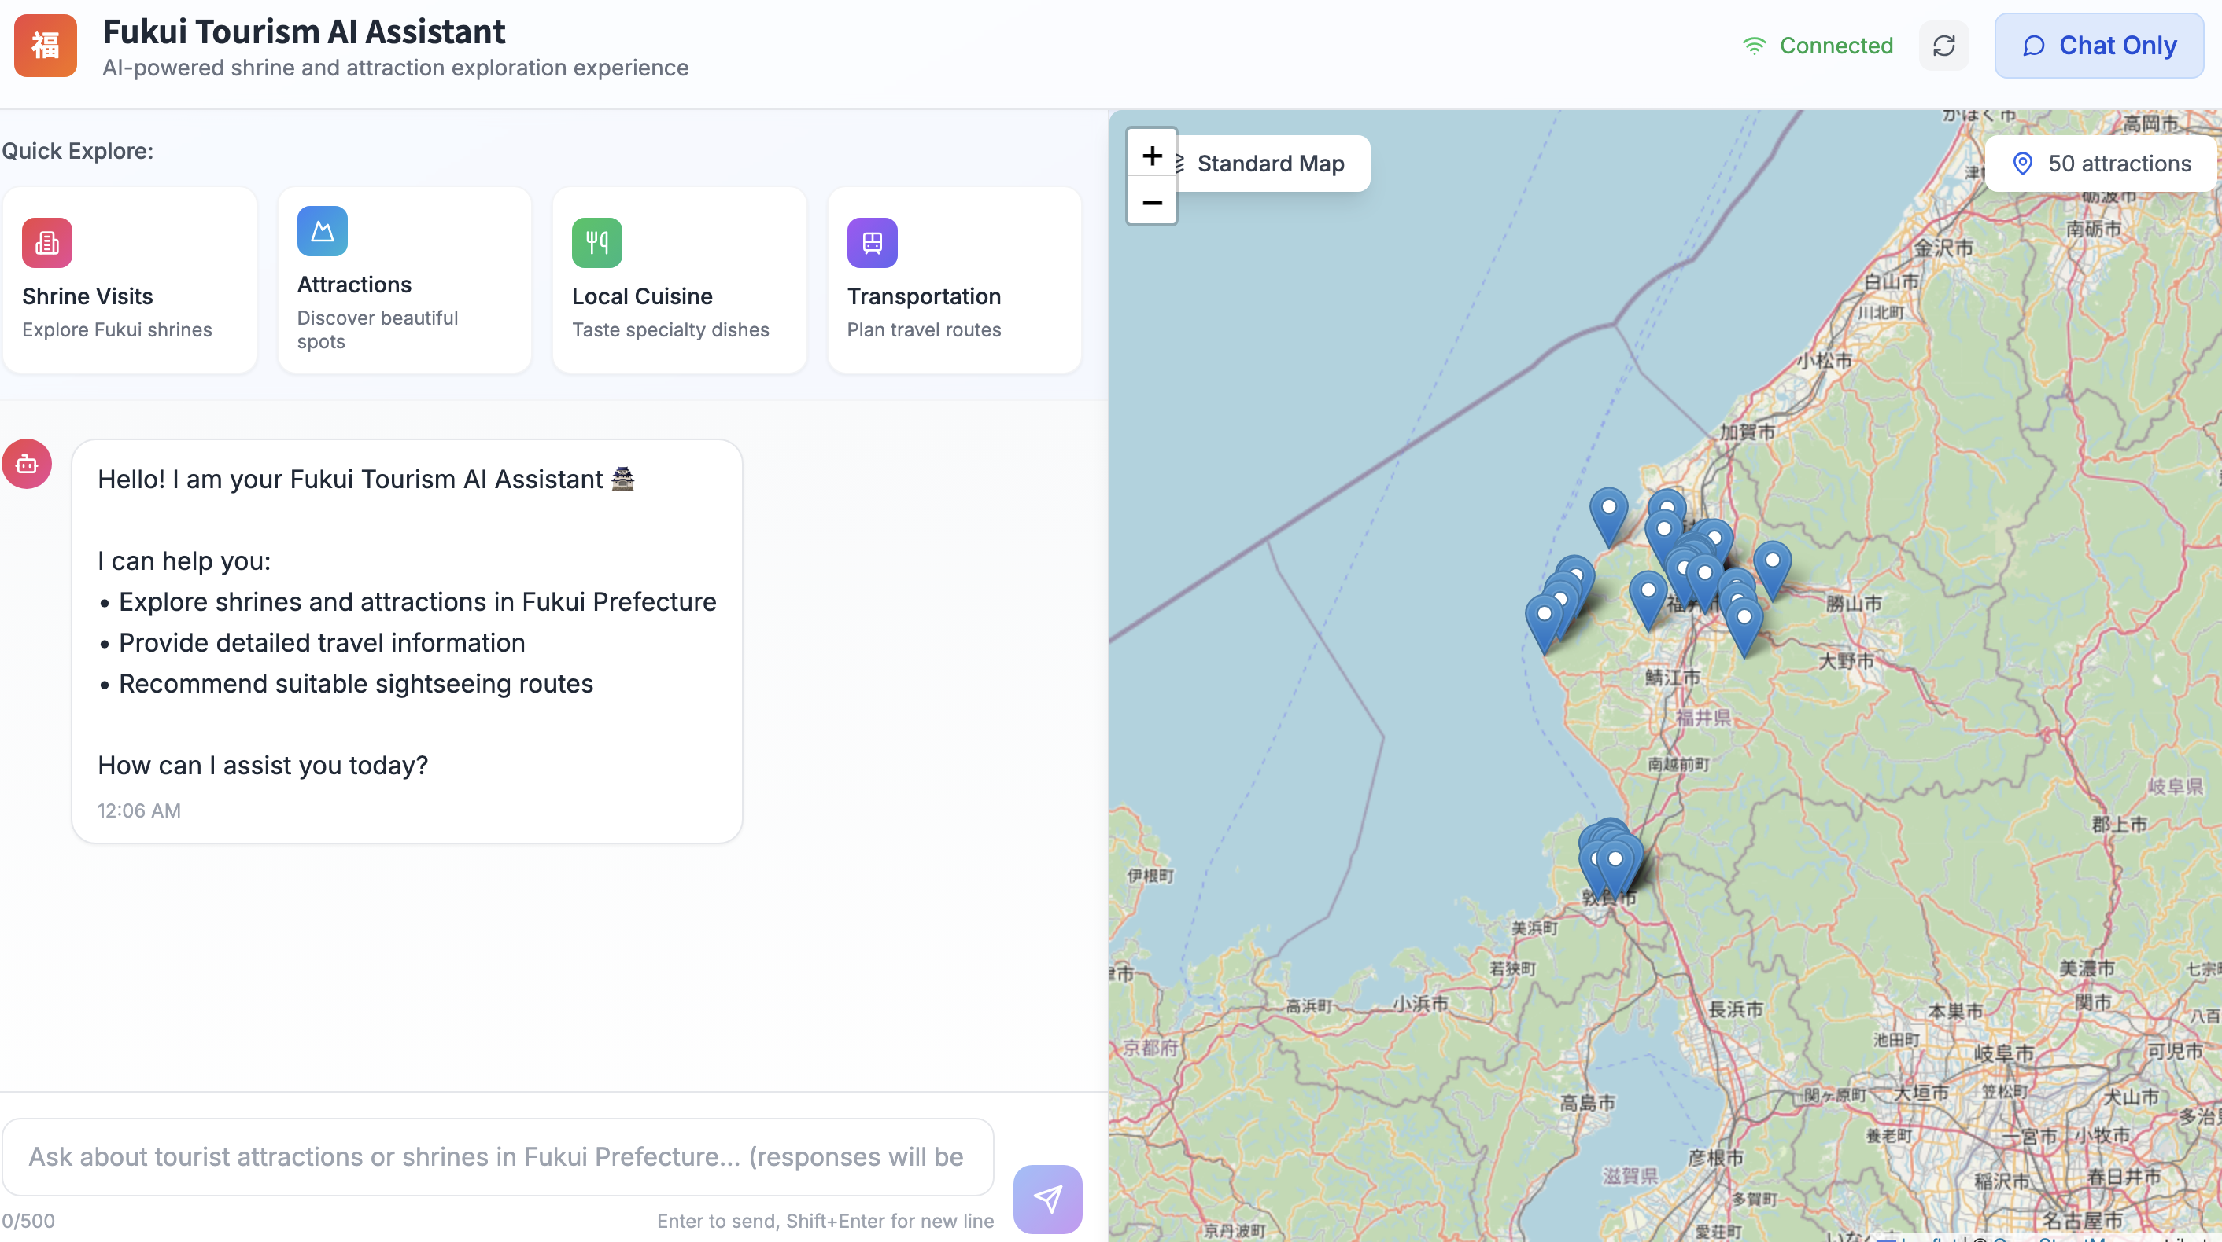
Progress
Homepage
Map Mode
Chat Mode
Conclusion
User Interface – Map Mode
Fukui’s Attraction
Visualizing Attractions
All attractions in Fukui Prefecture from our database are marked with pins on the map.
This rich dataset of attractions is built upon the results of the team's previous project.
Notes:
「當我們進入地圖模式後，大家可以看到，畫面的右半邊現在變成了一張互動式地圖。」
“In Map mode, the right side of the screen turns into an interactive map.”
「地圖上這些藍色的圖標，就代表了我們資料庫中所有的福井縣景點，使用者可以非常直觀地看到這些景點的地理分佈。而這些豐富的景點資料，是我們延續了上一次專案的成果，並將其無縫整合到這次的 AI 助理中。」
“These blue pins mark every tourist spot in Fukui Prefecture in our database. Users can quickly see where each place is on the map. We took this rich data from our last project and smoothly added it to the new AI shrine assistant.”

Slide 6
Progress
Homepage
Map Mode
Chat Mode
Conclusion
User Interface – Map Mode
Querying Attraction Details
Users can directly click on any attraction pin of interest on the map to get more detailed information about that location.
Click Attraction
Notes:
「當地圖上佈滿了景點時，使用者很自然地會想知道『這個點是什麼地方？』。」
“When the map is covered with pins, users naturally wonder, ‘What place is this?’”
「所以，使用者只需要移動滑鼠，點擊任何一個他感興趣的景點圖標，就像畫面上這樣。點擊之後，系統就會顯示出這個景點的詳細資料，我們下一張投影片就會看到結果。」
“Therefore, The user just needs to move the mouse and click any pin you like. The system will then show that spot’s details—we’ll see the result on the next slide.”

Slide 7
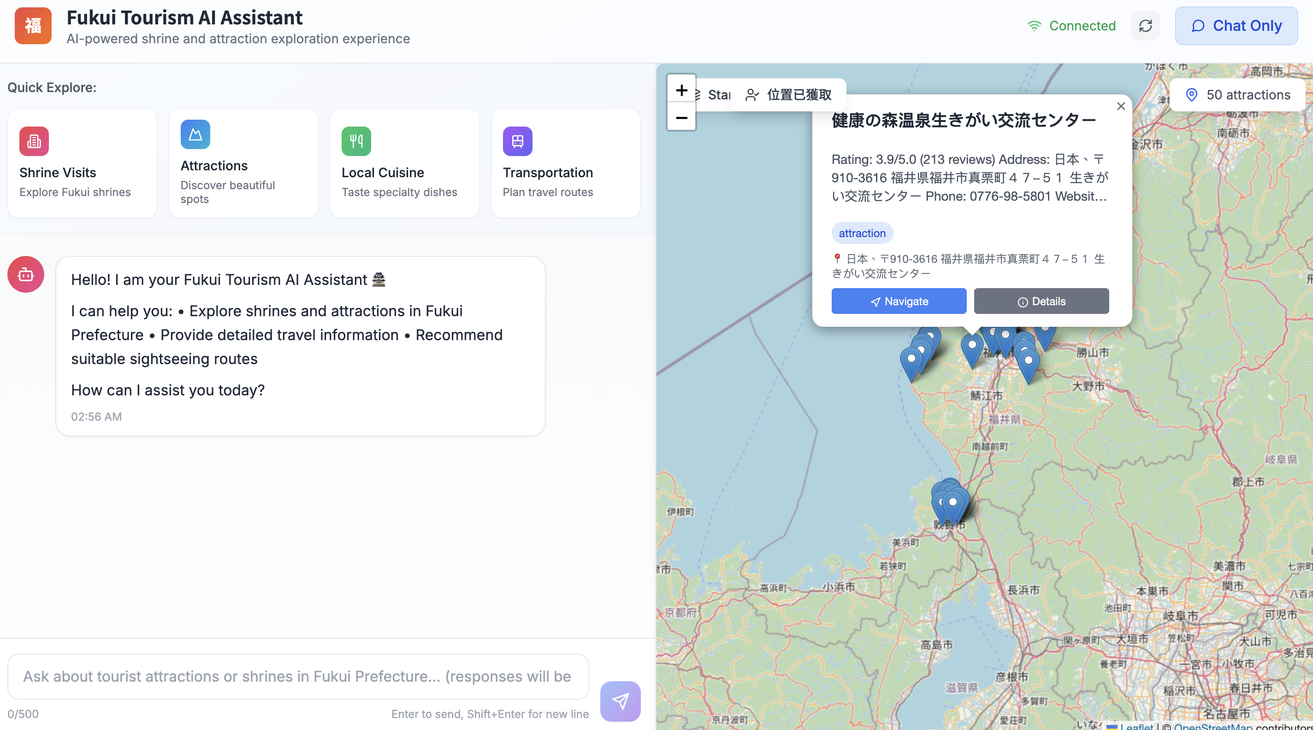
Progress
Homepage
Map Mode
Chat Mode
Conclusion
User Interface – Map Mode
2
Category Tags
Attraction Information Card
Displays a summary of the attraction upon clicking, including its name, rating, address, and phone number.
Features a system of over 30 attraction category tags (e.g., "amusement park," "museum") to help users quickly identify the type of location.
1
Attraction Summary
Notes:
「這張卡片就像是這個景點的迷你履歷，上面有它的名字、Google 評分、地址等等摘要資訊。」
“This card is a small profile of the spot. It lists the name, Google rating, address, and other quick facts.”
「更重要的是，為了讓使用者一眼就能知道這是什麼樣的地方，我們還特別設計了『分類標籤』。大家可以看到，目前我們總共定義了超過 30 種不同的標籤，涵蓋了『amusement park』、『museum』等各種不同的類型，讓使用者在瀏覽地圖時，資訊能夠一目了然。」
"More importantly, to help users understand what kind of place it is, we've designed a 'Category Tag' system. As you can see, We now have more than 30 tags—like ‘amusement park’ and ‘museum’—covering many kinds of places.This makes the information instantly clear as users browse the map."

Slide 8
Progress
Homepage
Map Mode
Chat Mode
Conclusion
User Interface – Map Mode
Click “Detail”
Notes:
「當使用者點擊「詳細資訊」的按鈕後，就可以看到這個景點的詳細介紹了。」
“After the user clicks the “Details” button, they will be able to see the detailed introduction of the attraction.”

Slide 9

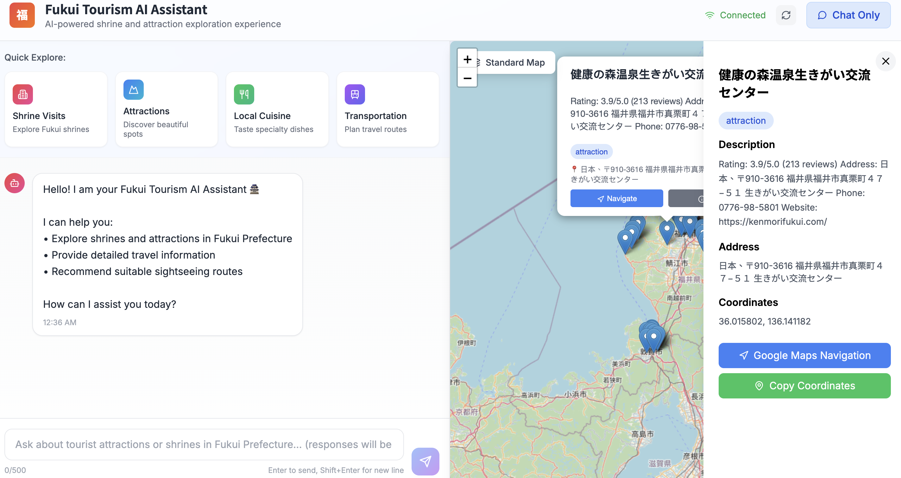

Progress
Homepage
Map Mode
Chat Mode
Conclusion
User Interface – Map Mode
Google Search Engine
Crawling From
Perplexity and Google Search Engine
Perplexity
Notes:
「側邊欄裡面有從 Google 地圖 API 和 Perplexity 擷取的資訊。」
“The sidebar contains information extracted from the Google Maps API and Perplexity.“

Slide 10
Progress
Homepage
Map Mode
Chat Mode
Conclusion
User Interface – Map Mode
Click “Google Maps Navigation”
Notes:
「使用者可以直接點擊 Google Maps 導航按鈕，來查看各個景點的資訊」
Users can simply click the Google Maps Navigation button to view information about various attractions

Slide 11
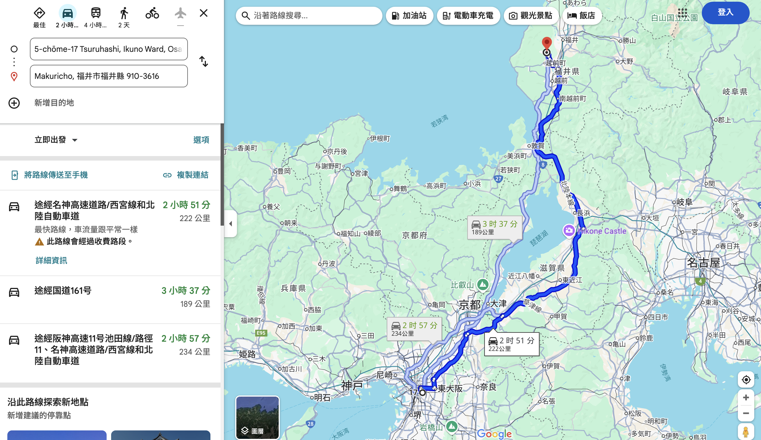
Progress
Homepage
Map Mode
Chat Mode
Conclusion
User Interface – Map Mode
One-Click Navigation & Route Planning
Deeply integrated with the Google Maps API, the system automatically plans the best route from the user's current location to the destination after clicking "Navigate".
Notes:
「最後，也是地圖模式最實用的一步。當使用者在剛剛的資訊卡片上點擊『Navigate』按鈕後，系統就會像這樣，直接開啟 Google Maps。」
“Finally, the handiest part of Map mode: when users press the ‘Navigate’ button on the infomation card, Google Maps opens right away.”
「大家可以看到，地圖會自動將使用者『當前的位置』設為起點，並立即規劃出前往目標景點的詳細路線，包含了開車需要多久、距離多遠等等所有旅客需要的細節。」
“You can see the map starts from your current location and instantly shows a full route to the chosen spot, with drive time, distance, and other key details.”
「這個功能解決了旅客『知道要去哪，但不知道怎麼去』的最大痛點，為使用者提供了從線上探索到線下實際出發的完整解決方案。」
“This feature removes the main pain point for travelers: knowing the destination but not the way. It gives a complete solution.”

Slide 12
Progress
Homepage
Map Mode
Chat Mode
Conclusion
User Interface – Chat Mode
Quick Explore Options
To guide the user, we provide a series of preset topic buttons.
Notes:
「介紹完強大的地圖模式後，我們回到這個應用的核心——『聊天模式』。」
"Now that we've covered the Map Mode, let's return to the core of this application—the 'Chat Mode'."
「為了避免有些使用者第一次使用時，不知道該從何問起，我們貼心地在介面上設計了這四個『快速探索』按鈕。這就像是給使用者的靈感提示。」
"To prevent a situation where first-time users might not know what to ask, “We added four Quick Explore buttons so new users know where to start. They act as prompts to spark ideas."

Slide 13
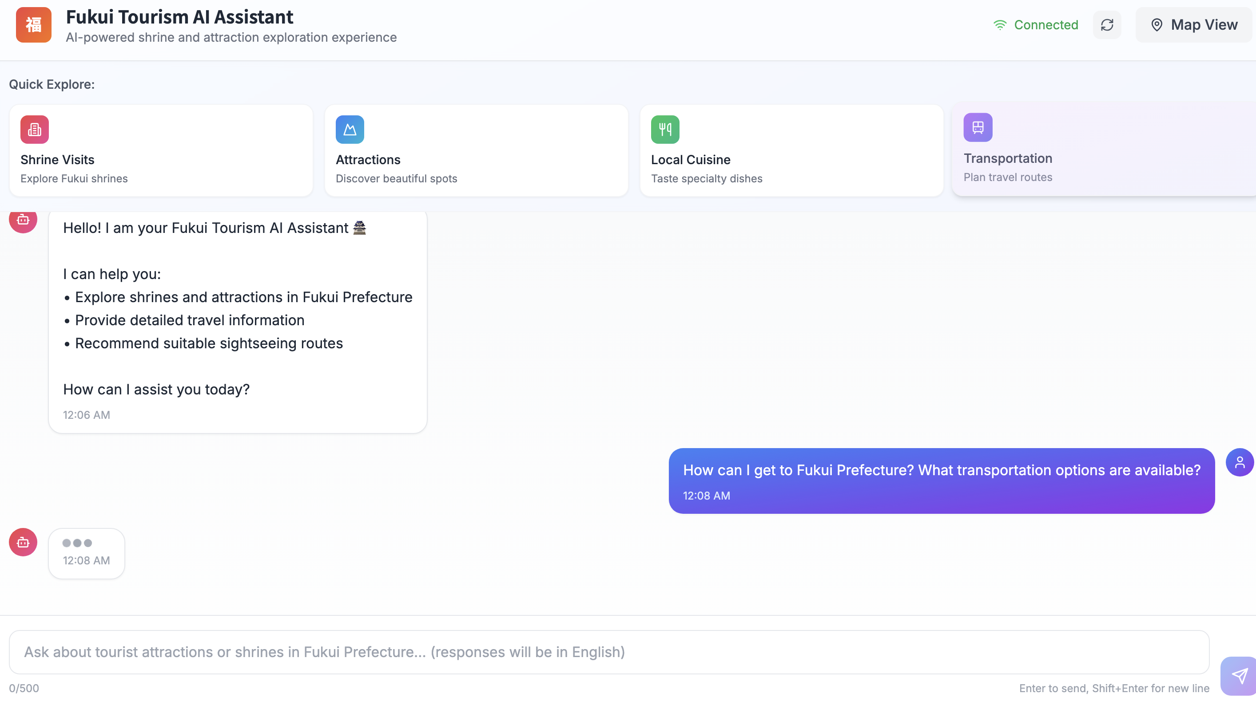
Progress
Homepage
Map Mode
Chat Mode
Conclusion
User Interface – Chat Mode
“Fukui Transportation” as an example：
A corresponding question is auto-generated after clicking the quick button.
Once submitted, the system quickly searches ChromaDB to retrieve the most relevant local information.
ChromaDB
Notes:
「舉例來說，如果使用者對福井的交通有興趣，他只需要點擊『Transportation』這個按鈕，系統就會幫他提出問題，非常方便。」
"For instance, if a user is interested in Fukui's transportation, they can simply click the 'Transportation' button, and the system will generate the question for them. It is convenient."
「當這個問題一送出，我們後端的流程就啟動了。如圖所示，系統會將這個問題的『語意』，送到我們的核心資料庫，也就是 ChromaDB 向量資料庫 裡，進行比對。」
“Once the question is sent, the backend starts working. The system sends the question’s meaning to our main database, ChromaDB, to look for matches.”
「它會在我們預先存入的大量福井在地資料中，用非常快的速度，精準地找出與『福井交通』這個主題最相關的幾份文件，然後準備用這些資料來生成回覆。」
“Then,It quickly pulls the key files on Fukui transport from our local data and uses them to generate a reply.”

Slide 14
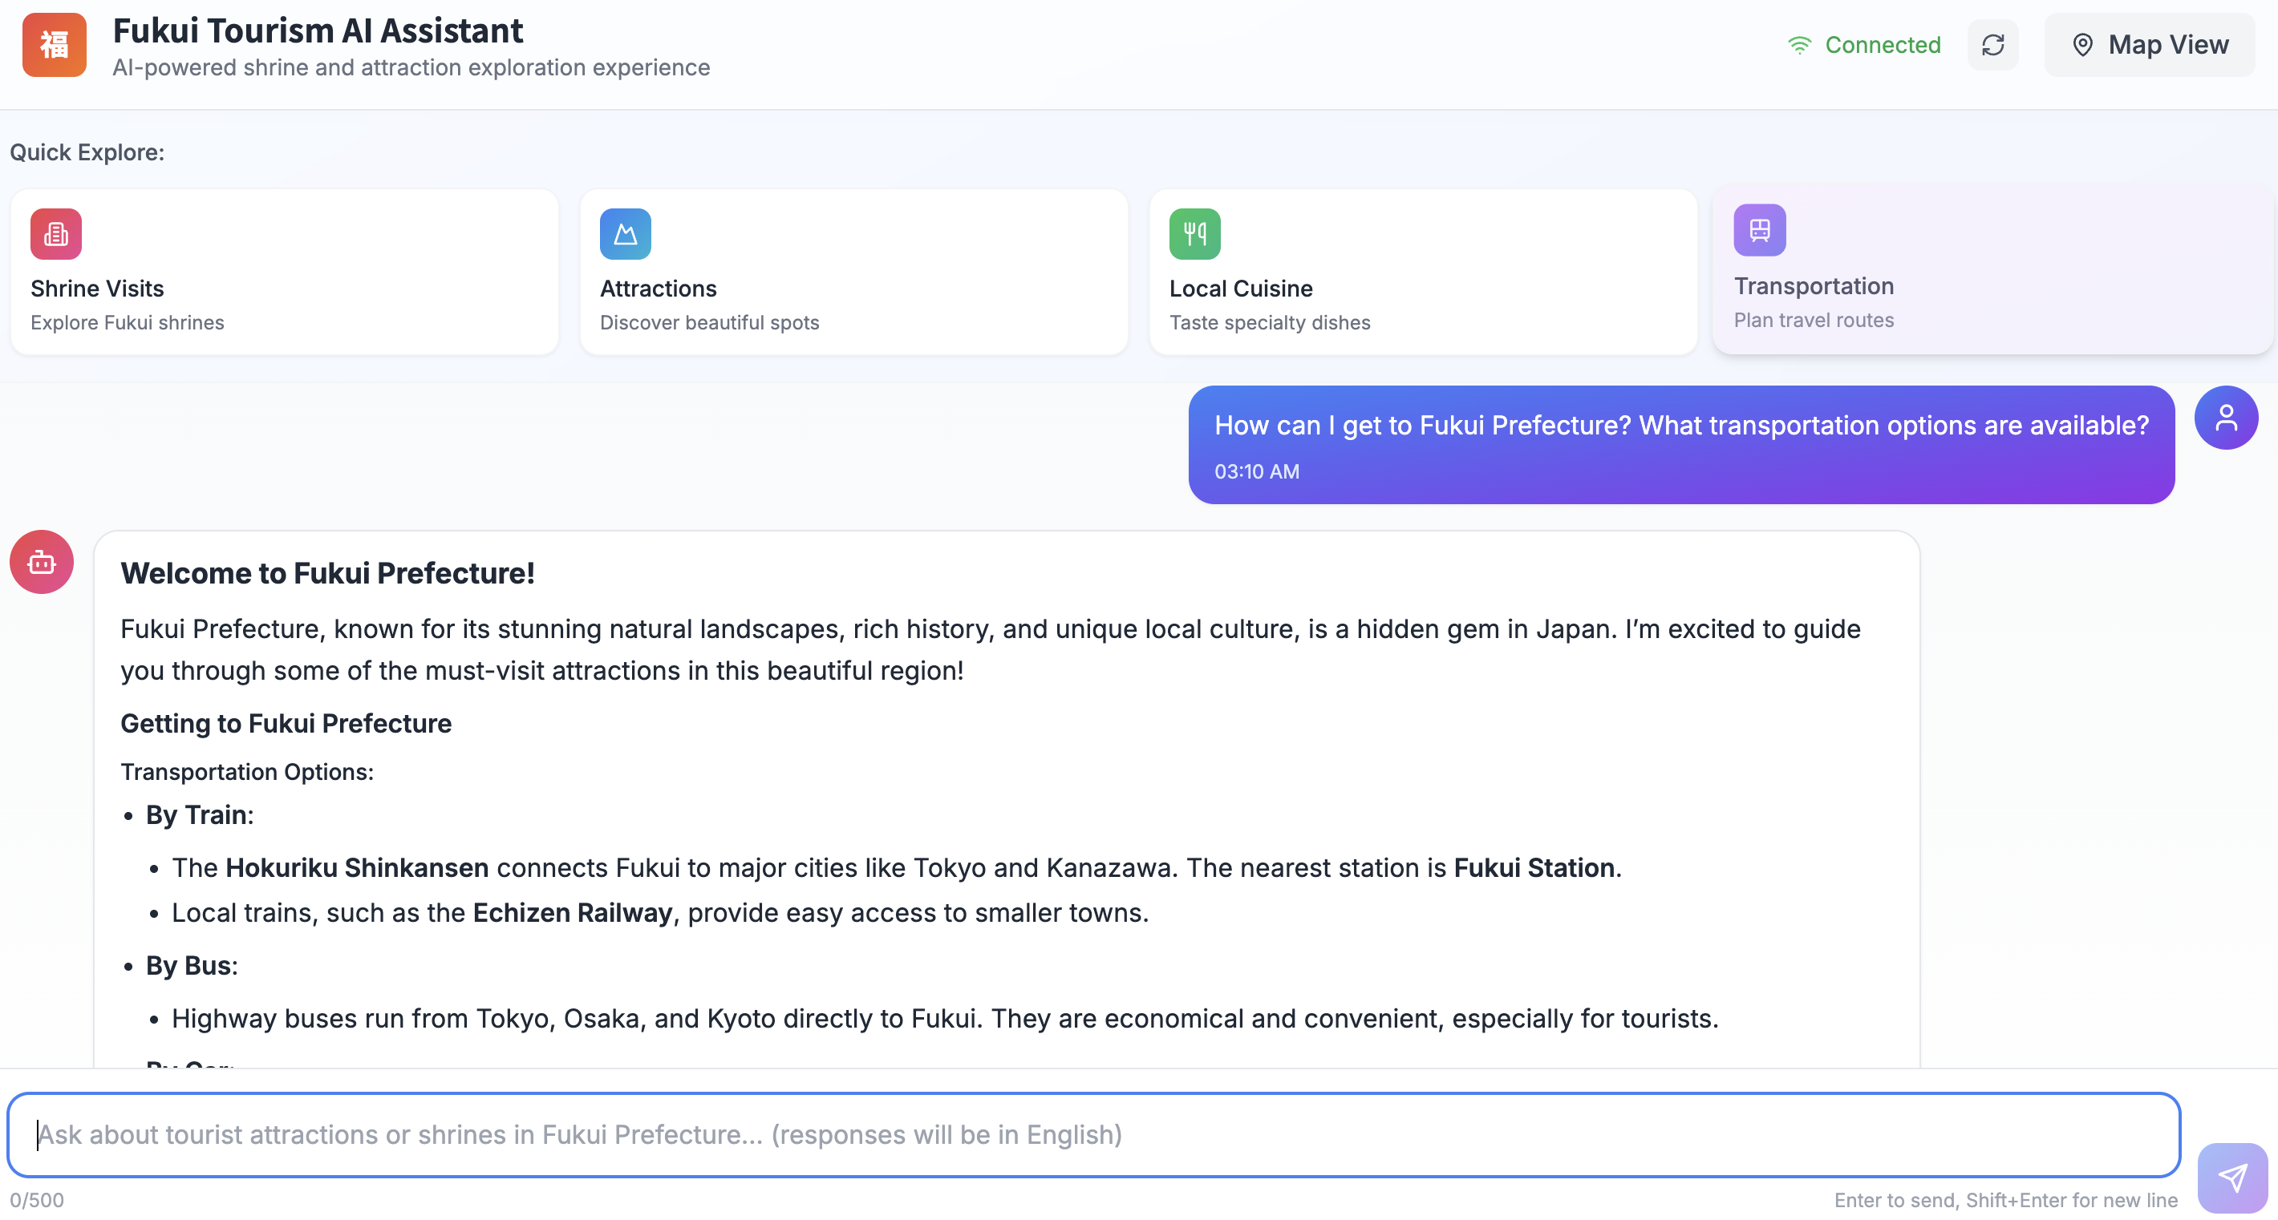
Progress
Homepage
Map Mode
Chat Mode
Conclusion
User Interface – Chat Mode
AI Response Generation & Polishing
Polishing Process: Using a GPT model for response better organization and clarity.
Role-Playing: The AI assumes the role of a “professional tour guide”.
Notes:
「當拿到原始的交通資訊後，我們會把它們連同使用者的問題，一起交給 GPT 模型。就像大家在畫面上看到的這段 prompt，我們在這裡給了 AI 一個非常明確的指令，請它扮演一位『專業導遊』來回答這個問題。」
“After we get the transport details, we send them with the user’s question to GPT. In the prompt, we clearly tell GPT to answer like a professional tour guide.”

Slide 15
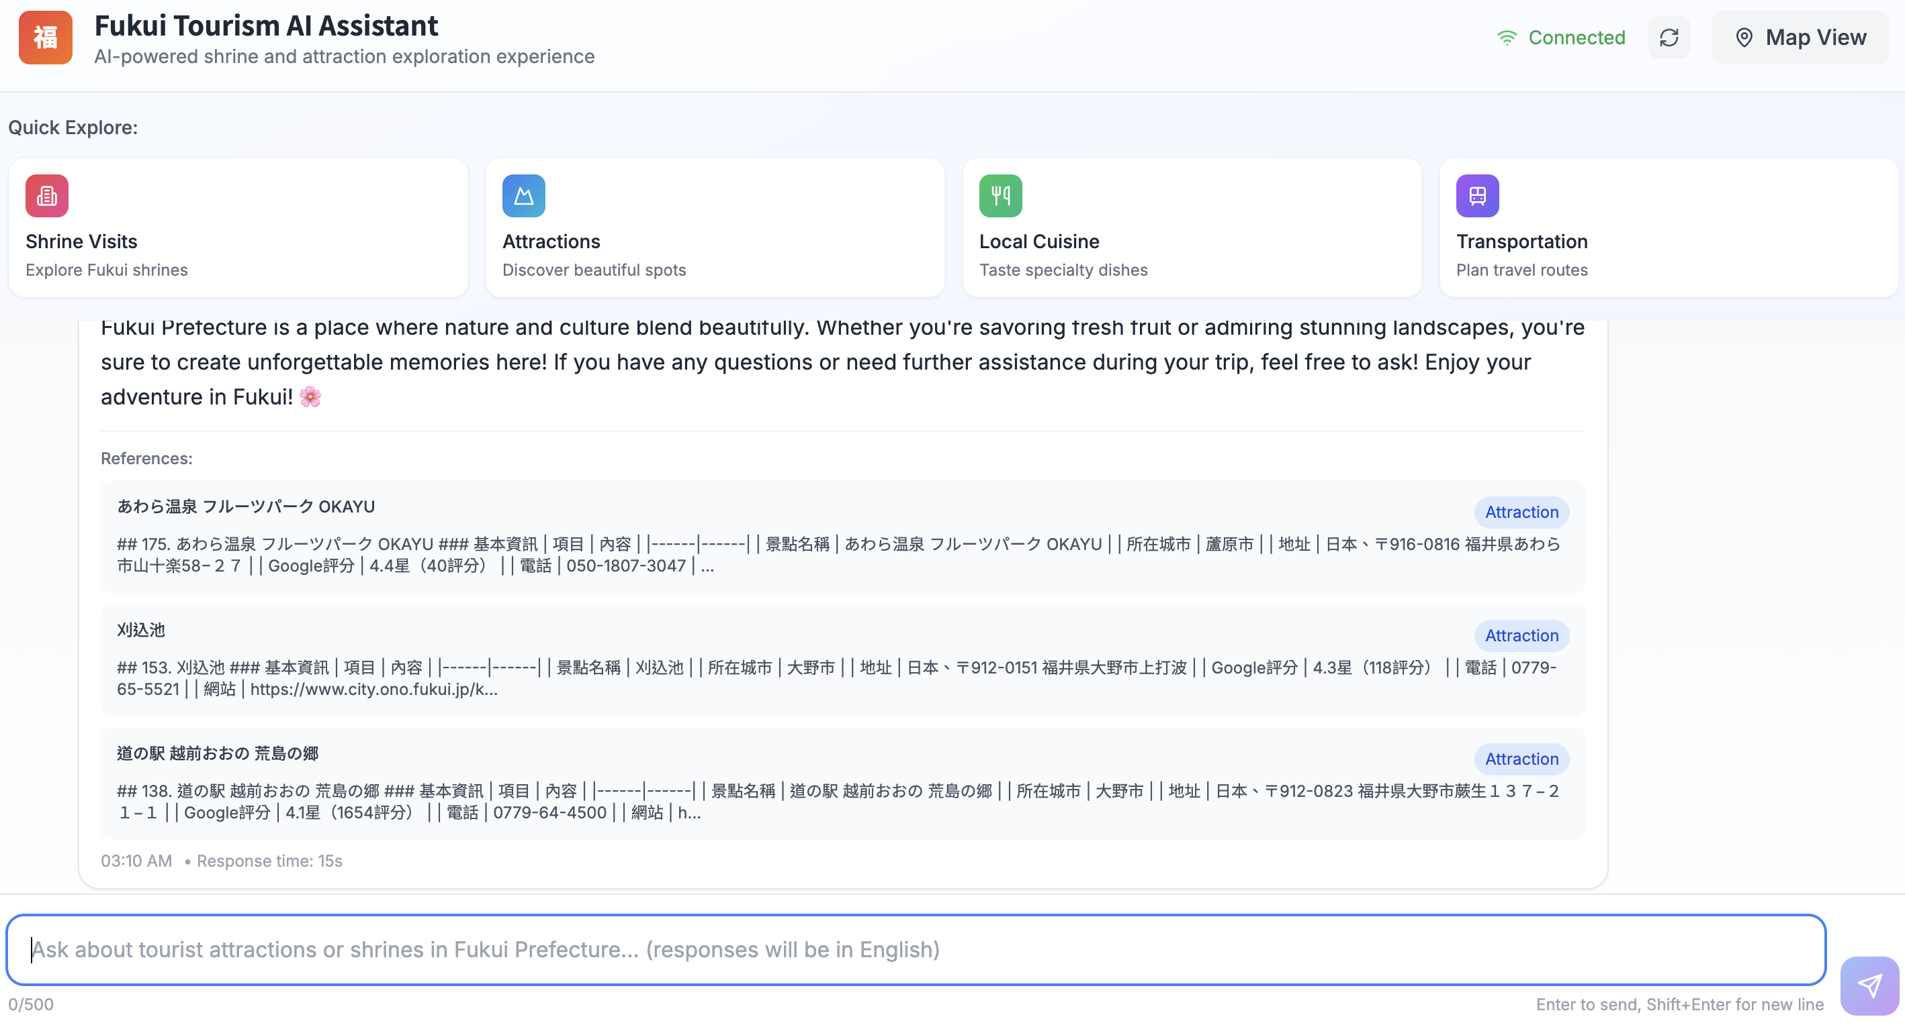
Progress
Homepage
Map Mode
Chat Mode
Conclusion
User Interface – Chat Mode
Attaching References:
Below each AI response, the system automatically lists the data sources that were referenced to generate that answer.
Notes:
「為了建立使用者對我們 AI 助理的信任感，我們認為『資訊透明』是至關重要的。」
"To build user trust in our AI assistant, we believe that 'information transparency' is crucial."
「因此，在每一則由 AI 生成的回答下方，我們都會像畫面上這樣，清楚地列出這則回答是參考了我們資料庫中的哪些原始資料。使用者可以看到景點的名稱、地址、甚至是原始的網站連結。」
“Under every AI answer, we list the sources it used. Users can see the place’s name, address, and even the original website link.”

Slide 16
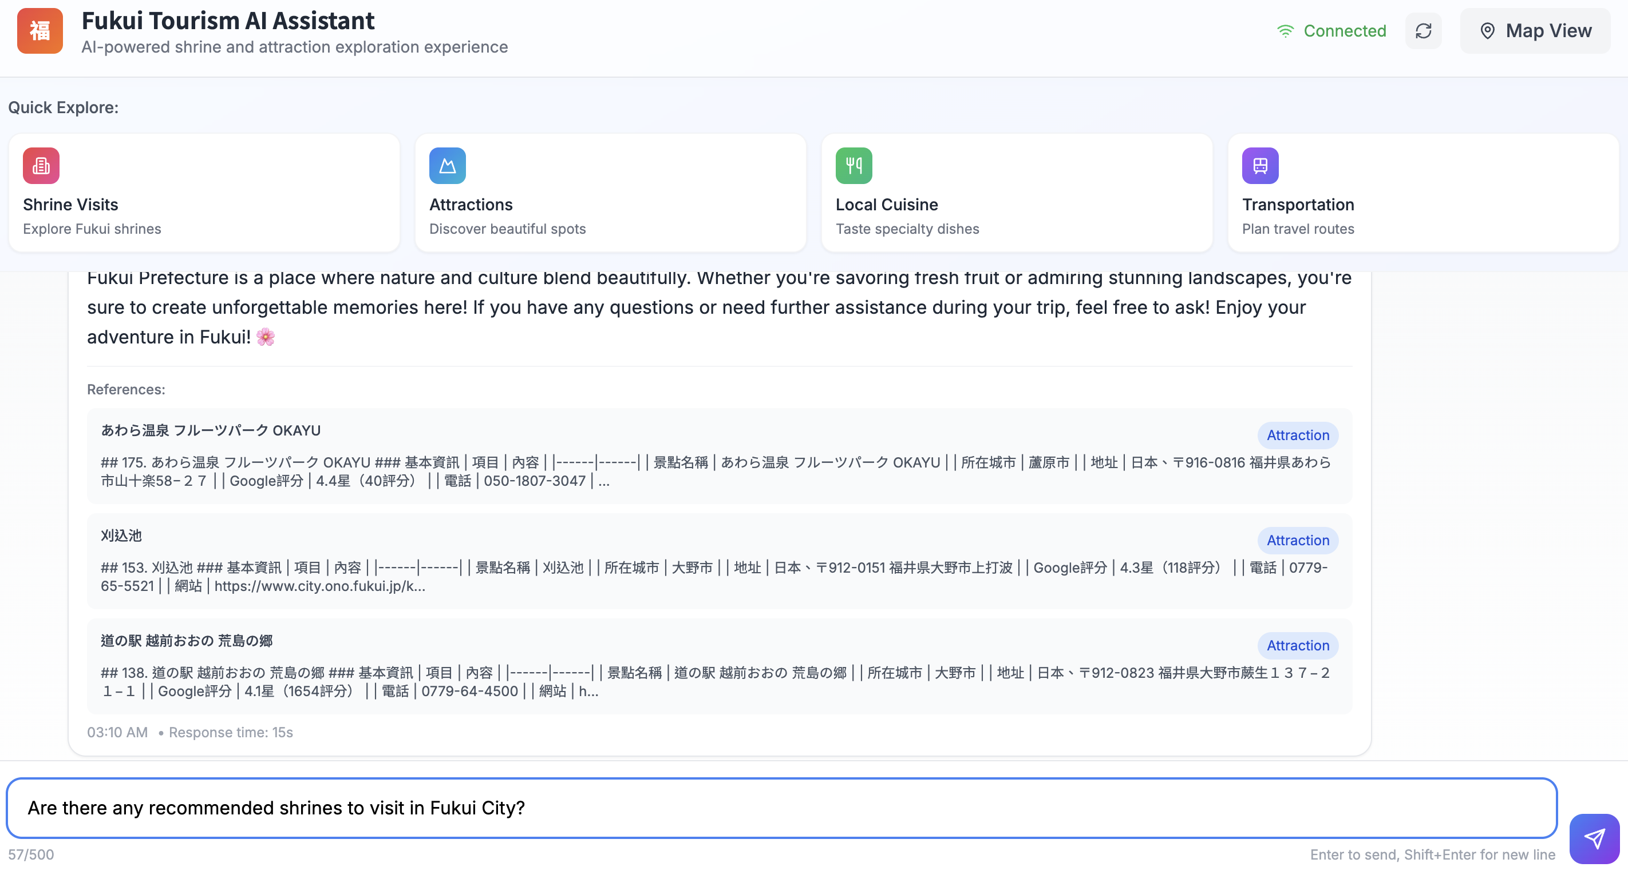
Progress
Homepage
Map Mode
Chat Mode
Conclusion
User Interface – Chat Mode
Free-form Natural Language Query
Notes:
「快捷按鈕雖然方便，但我們 AI 助理真正的強大之處，在於能處理使用者各式各樣的提問。」
“The quick buttons are useful, but our AI assistant’s real strength is answering all kinds of questions users ask.”
「使用者完全不需要被我們預設的題目所限制。就像畫面上這個例子，在詢問完交通之後，他可以隨時接著問一個完全不同的問題，例如：『福井市區有沒有推薦的神社？』」
“Users are not limited to our suggested questions. After asking about transport, they can jump to a completely new one, such as, ‘Can you recommend shrines in Fukui City?’”

Slide 17
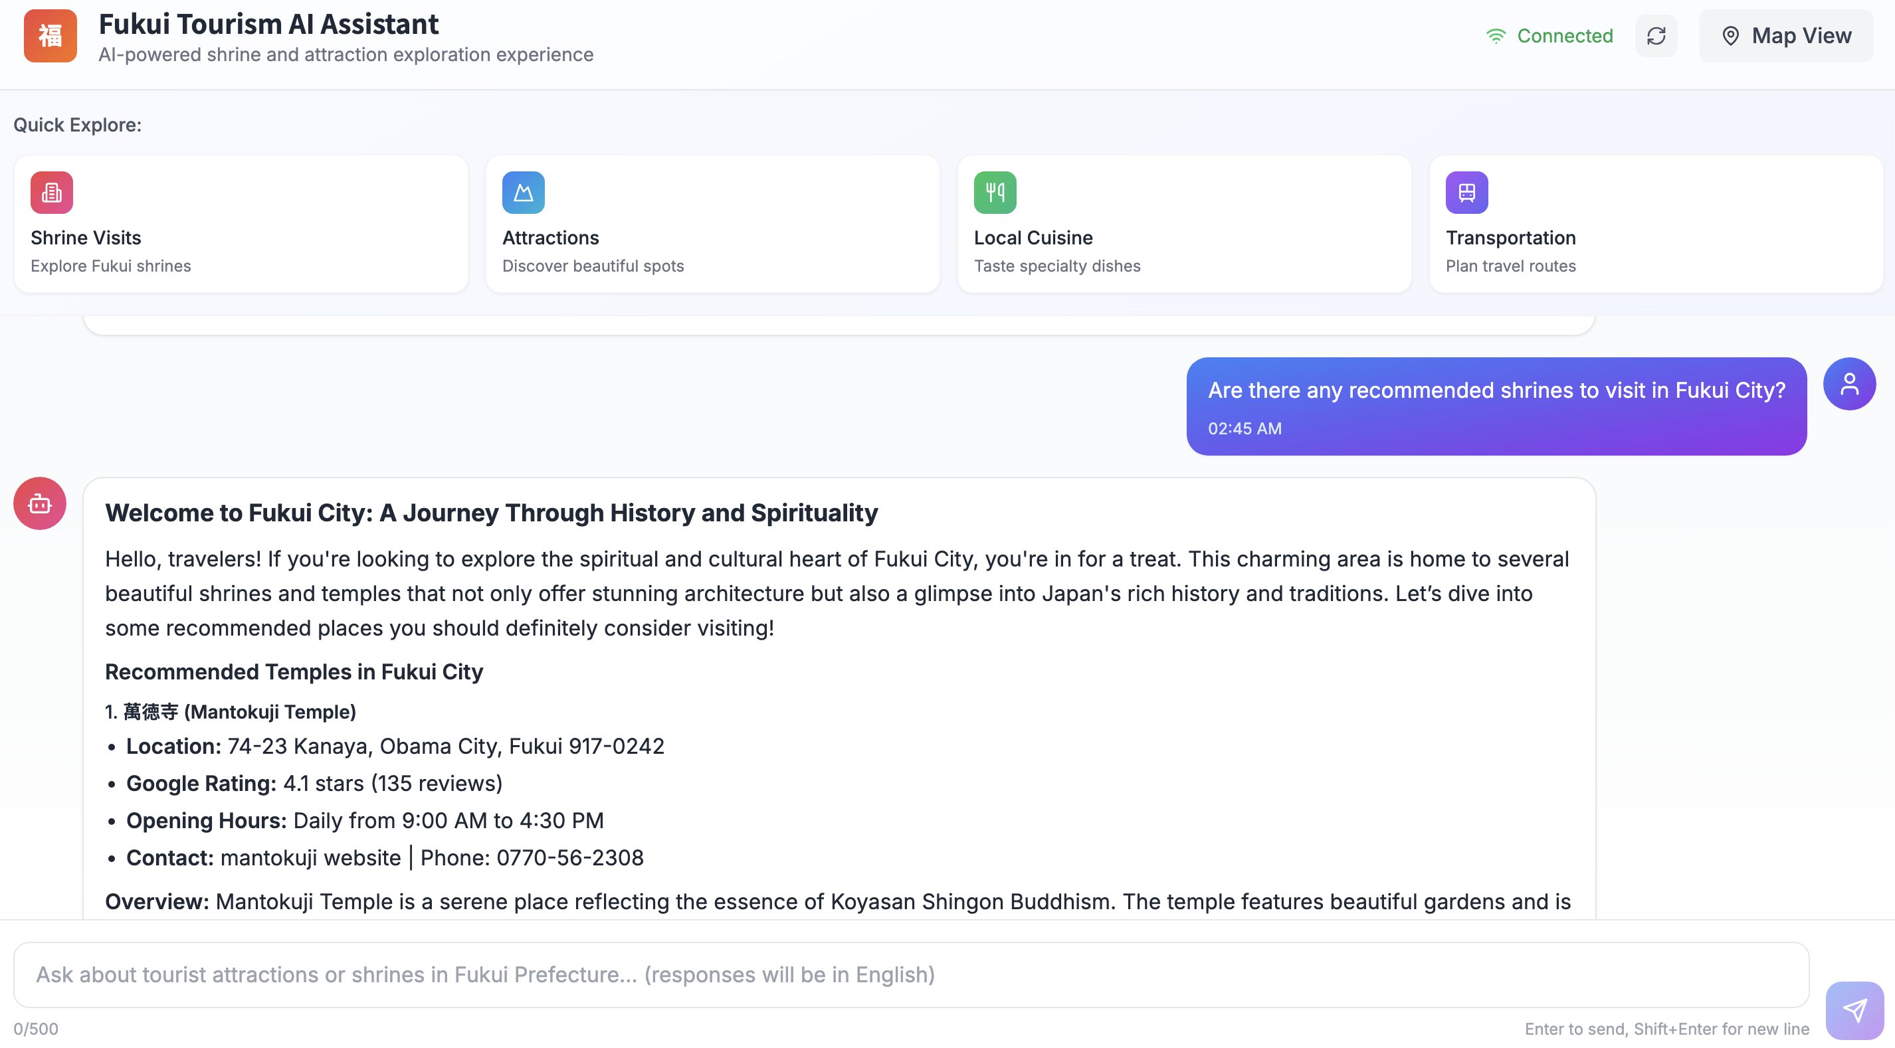
Progress
Homepage
Map Mode
Chat Mode
Conclusion
User Interface – Chat Mode
Intelligent Recommendations & Precise Answers
Result Demonstration: The system accurately understands the user's query intent (e.g., "recommend shrines" in this example).
Notes:
「它不僅理解了使用者想找的是『神社』，還提供了像是『萬德寺』的具體資訊，從地點、Google 評分、開放時間，到完整的特色簡介，幾乎涵蓋了旅客規劃行程時所需要知道的一切。」
"It didn't just understand that the user was looking for 'shrines,' but it also provided specific information for places like 'Mantokuji'—from its location, Google rating, and opening hours, to a full overview of its features. It covers almost everything a traveler needs to plan their trip."

Slide 18
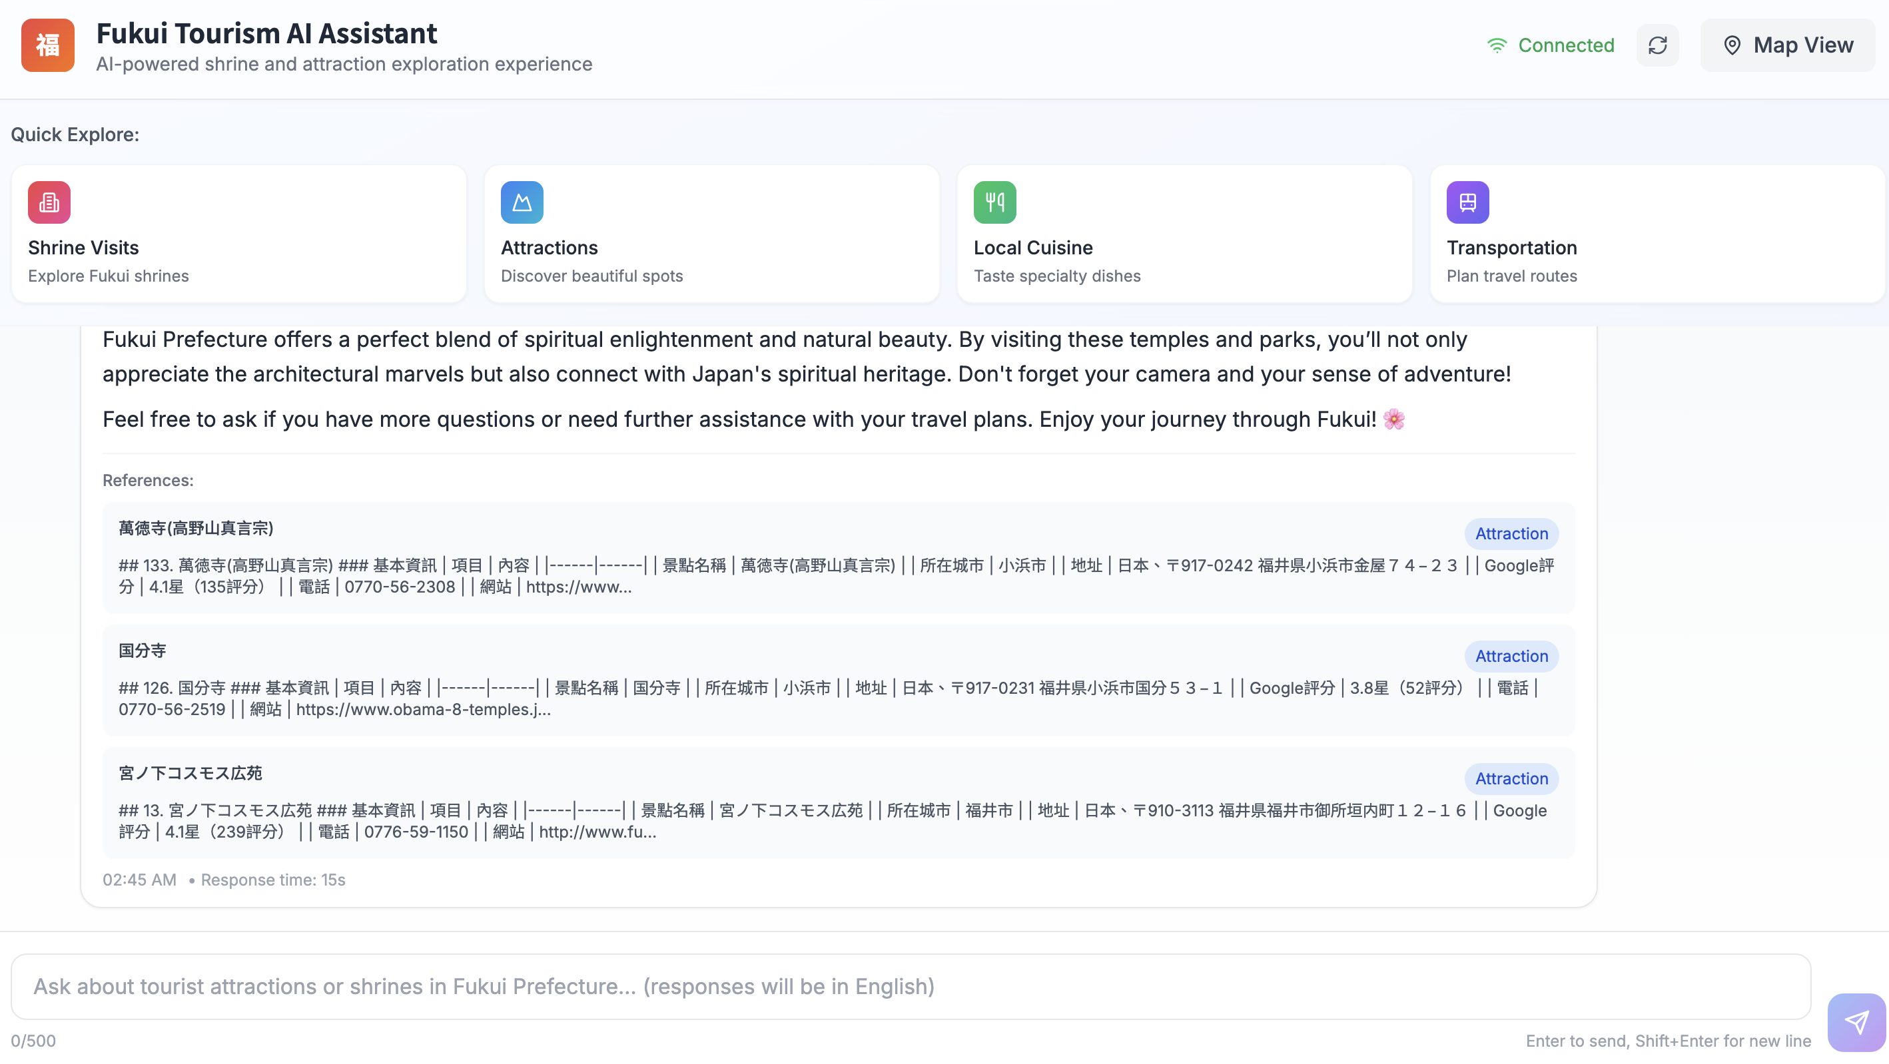
Progress
Homepage
Map Mode
Chat Mode
Conclusion
User Interface – Chat Mode
Attaching References
Notes:
「同樣我們可以得知系統查找的相關來源資訊。」
“Similarly, we can also see which sources the system used.”

Slide 19

Progress
Homepage
Map Mode
Chat Mode
Conclusion
User Interface
Frontend
React 18
TypeScript
LLM
Backend
GPT-4o mini
FastAPI
ChromaDB
Notes:
「以上就是現階段系統的整體架構。」
“This is the overall structure of the system at the current stage.”

Slide 20
Progress
Homepage
Map Mode
Chat Mode
Conclusion
This Week's Progress: Successfully built a prototype travel app combining conversational AI with an interactive map.
Future Work:
Map Feature Enhancements
Add a dedicated filter for shrines.
Recommend local businesses near attractions.
Implement QR codes for easy scanning by tourists and data tracking by authorities.
Information Display Optimization
Redesign the layout of attraction details for a better user experience.
Notes:
這週我們成功完成了一個旅遊 App 的原型，結合了互動地圖和聊天式 AI，幫助使用者更輕鬆規劃行程。
This week, we built a prototype of travel app that combines an interactive map with conversational AI, making trip planning easier for users.
接下來的優化方向有兩個重點：
Next, we’ll focus on two main areas for improvement:
第一，地圖功能強化：我們會加入神社的篩選器、推薦景點附近的在地商家，還會導入 QR code，方便旅客掃描導航，也有助於數據追蹤。
First, We plan to add a shrine filter, recommend local businesses near attractions, and add QR codes for easier access and better data tracking.
第二，資訊顯示優化：我們會重新設計景點資訊的版面，讓使用者在瀏覽時更清楚、也更直觀。
Second, We’ll redesign the layout of attraction details to make clearer and more user-friendly.

Slide 21
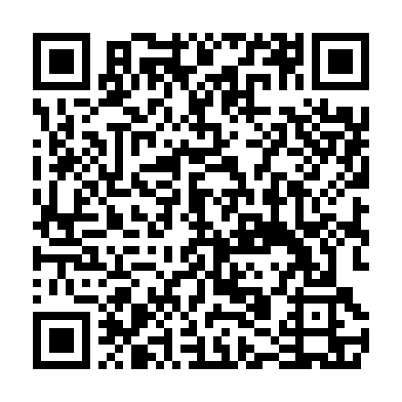
Progress
Homepage
Map Mode
Chat Mode
Conclusion
Future Work
Revamp the information card for attractions for improved structure and readability.
1
Attraction Card Redesign
2
QR Code Implementation
For Users: A unique QR code for each attraction allows easy access and sharing.
For Administration: Scan data helps local governments and tourism bureaus track popularity and shape marketing strategies.
Notes:
「介紹完我們目前的成果後，接下來我想說明一下未來的幾個重點工作。」
"After demonstrating our current progress, I'd like to outline our key focus areas for future work."
「首先，我們會優先『優化資訊呈現』。大家可以看到這張示意圖，我們會將目前的資訊卡片，設計得更像一個儀表板，讓內容更結構化，使用者一眼就能抓到重點，提升整體的易讀性。」
“We’ll first focus on making the infomation easier to see. We’ll redesign the card into a dashboard, so everything is well-organized and users can spot the key points right away.”
「其次，是一個我們認為非常有潛力的功能：『導入 QR Code』。我們計畫在卡片上生成一個該景點專屬的 QR Code。這麼做有雙重好處：對使用者來說，他們掃一下就能輕鬆地把資訊存到手機裡；而另一方面，對福井的觀光單位來說，他們可以透過後台分析掃描數據，精準了解哪些景點最受歡迎，這對未來的觀光推廣非常有幫助，是一個能為使用者和管理者創造雙贏的功能。」
“Second, we want to add QR codes. Each attraction will have its own code on the info card. Visitors can scan it to save the details on their phones. Fukui’s tourism office can also see which codes get the most scans to learn which spots are popular. This helps both travelers and planners.”

Slide 22
Progress
Homepage
Map Mode
Chat Mode
Conclusion
Future Work
Theme Enhancement: To align with the project's theme of "Shrine & Temple Navigation," a dedicated "Shrine" filter will be added to the existing map.
Adding a Shrine Filter
Notes:
「另外，我們也注意到，目前地圖上顯示的是所有景點的綜合資訊。但我們的專案核心是『神社與景點導覽』，所以，我們認為強化『神社』這個主題非常重要。」
“We saw that the map shows all kinds of spots together. But because our project centers on shrine and temple guides, we need to put extra focus on shrines.”
「因此，我們的下一步計畫，就是在地圖上添加獨立的『神社篩選功能』。啟用這個功能後，地圖上就只會顯示神社的位置，這對於那些專門想要進行神社巡禮的旅客來說，將會是一個非常貼心且重要的功能，能幫助他們更有效率地規劃行程。」
“So our next step is to add a ‘shrine filter’ to the map. When it’s on, the map will show only shrines. This will be very handy for travelers doing a shrine tour and will help them plan their trip more easily.”

Slide 23
Progress
Homepage
Map Mode
Chat Mode
Conclusion
Future Work
Nearby Business Recommendations
From "Point" to "Area": Evolving the recommendation logic from single attractions to surrounding businesses.
Notes:
「最後，為了讓我們的 AI 助理更貼心、更像一個真正的在地嚮導，我們希望能將推薦的格局從『單點』擴大到『區域』。」
“Finally, to make the AI feel like a real local guide, we’ll widen its tips from single spots to whole areas.”
「也就是說，目前系統在推薦完一個主要景點，像是萬德寺之後，就結束了。未來，我們希望它能主動地、智慧地接著告訴使用者：『逛完萬德寺，附近還有很棒的餐廳或咖啡廳喔！』」
"In other words, Now after the system recommends a main spot like Mantokuji , it stops. Next, we want it to smartly say, ‘After you visit Mantokuji , there are some nice restaurants and cafés nearby!’”

Slide 24
Thank You!
2025/07/25

